Slide 1
Fuzzy Logic

Slide 2
Fuzzy
The word fuzzy refers to things which are not clear or are vague. Any event, process, or function that is changing continuously cannot always be defined as either true or false, which means that we need to define such activities in a Fuzzy manner.

Slide 3
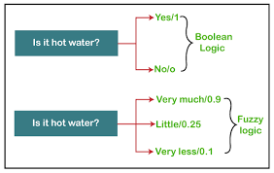
Fuzzy-Logic
Fuzzy Logic resembles the human decision-making methodology. It deals with vague and imprecise information. This is gross oversimplification of the real-world problems and based on degrees of truth rather than usual true/false or 1/0 like Boolean logic.
Take a look at the following diagram. It shows that in fuzzy systems, the values are indicated by a number in the range from 0 to 1. Here 1.0 represents absolute truth and 0.0 represents absolute falseness. The number which indicates the value in fuzzy systems is called the truth value.

Slide 4
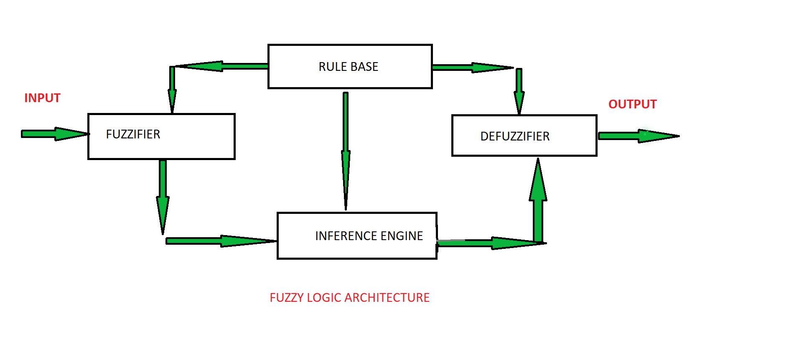
Fuzzy Architecture

Slide 5
Fuzzy-Architecture
RULE BASE: It contains the set of rules and the IF-THEN conditions provided by the experts to govern the decision-making system, on the basis of linguistic information. Recent developments in fuzzy theory offer several effective methods for the design and tuning of fuzzy controllers. Most of these developments reduce the number of fuzzy rules.
FUZZIFICATION: It is used to convert inputs i.e. crisp numbers into fuzzy sets. Crisp inputs are basically the exact inputs measured by sensors and passed into the control system for processing, such as temperature, pressure, rpm’s, etc.
INFERENCE ENGINE: It determines the matching degree of the current fuzzy input with respect to each rule and decides which rules are to be fired according to the input field. Next, the fired rules are combined to form the control actions.
DEFUZZIFICATION: It is used to convert the fuzzy sets obtained by the inference engine into a crisp value. There are several defuzzification methods available and the best-suited one is used with a specific expert system to reduce the error.

Slide 7
Example of Fuzzy Set
If we categorize the speed of a car as ‘Slow’ or ‘fast’ using crisp set-
If speed (x)<=40 ↔ μ = 0
If speed (x)>40 ↔ μ = 1
If we categorize the speed of a car as ‘Slow’ or ‘fast’ using Fuzzy Set-
If speed (x)<=40 ↔ μ = 0, Fuzzy set (x,0)
If 40 < speed(x) < 50 ↔ μ = (x-40)/10, Fuzzy set (x, μ)
If speed (x)>=50 ↔ μ = 1, Fuzzy set (x, 1)
For x= 42,
μ = (42-40)/10 =0.2μ = (45-40)/10 =0.5

Slide 8
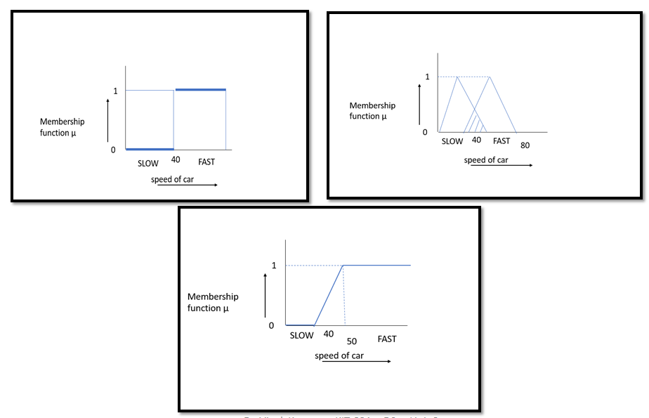
Example of Fuzzy Set

Slide 9
Membership Function
A membership function for a fuzzy set A on the universe of discourse X
is defined as μA : X -> [0,1], where each element of X is mapped to a value
between 0 and 1.
This value, called membership value or degree of membership, quantifies
the grade of membership of the element in X to the fuzzy set A.
Membership functions characterize fuzziness (i.e., all the information in
fuzzy set), whether the elements in fuzzy sets are discrete or continuous.
Membership functions can be defined as a technique to solve practical
problems by experience rather than knowledge.
Membership functions are represented by graphical forms.

Slide 10
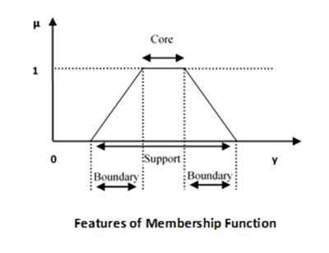

Slide 11
Feature of The Membership Function
Core :
The core of a membership function for some fuzzy set is defined as that region of the universe that is characterized by complete and full membership in the set.
b. The core comprises those elements x of the universe such that
Support :
a. The support of a membership function for some fuzzy set A is
defined as that region of the universe that is characterized by nonzero membership in the set A.
b. The support comprises those elements x of the universe such that

Slide 12
Feature of The Membership Function
3. Boundaries :
The boundaries of a membership function for some fuzzy set are defined as that region of the universe containing elements that have a non-zero membership but not complete membership.
The boundaries comprise those elements x of the universe such that

Slide 13
Benefits of Fuzzy Logic in Real Life
1. Fuzzy logic is essential for the development of human-like capabilities for AI.
2. It is used in the development of intelligent systems for decision making, identification, optimization, and control.
3. Fuzzy logic is extremely useful for many people involved in research and development including engineers, mathematicians, computer software developers and researchers.
4. Fuzzy logic has been used in numerous applications such as facial pattern recognition, air conditioners, vacuum cleaners, weather forecasting systems, medical diagnosis and stock trading.

Slide 14
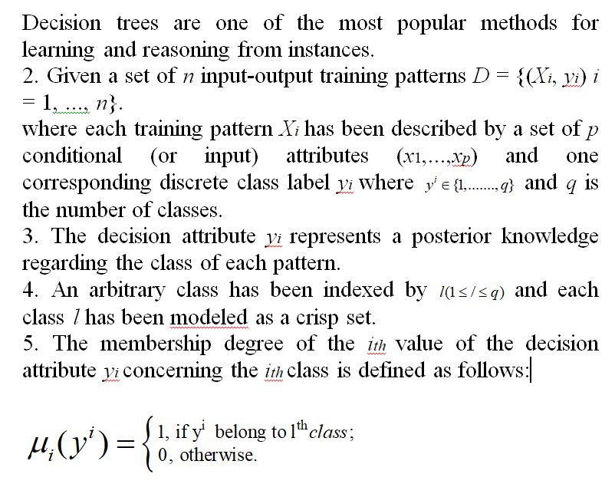
Fuzzy Decision Tree

Slide 15
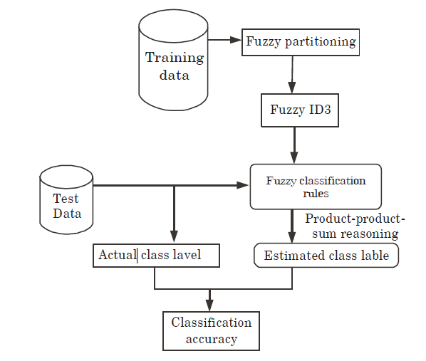
1. The generation of FDT for pattern classification consists of three major
steps namely fuzzy partitioning (clustering), induction of FDT and fuzzy rule inference for classification.
2. The first crucial step in the induction process of FDT is the fuzzy partitioning of input space using any fuzzy clustering techniques.
3. FDTs are constructed using any standard algorithm like Fuzzy ID3
where we follow a top-down, recursive divide and conquer approach, which makes locally optimal decisions at each node.
4. As the tree is being built, the training set is recursively partitioned into smaller subsets and the generated fuzzy rules are used to predict the class of an unseen pattern.

Slide 16
Stochastic Search Methods
Stochastic optimization algorithms provide an alternative approach that permits less optimal local decisions to be made within the search procedure that may increase the probability of the procedure locating the global optima of the objective function.
Stochastic search and optimization pertains to problems where there is randomness noise in the measurements provided to the algorithm and/or there is injected (Monte Carlo) randomness in the algorithm itself.
Methods for stochastic optimization provide a means of coping with inherent system noise and coping with models or systems that are highly nonlinear, high dimensional, or otherwise inappropriate for classical deterministic methods of optimization.
The use of randomness in the algorithms often means that the techniques are referred to as “heuristic search” as they use a rough rule-of-thumb procedure that may or may not work to find the optima instead of a precise procedure.
Many stochastic algorithms are inspired by a biological or natural process and may be referred to as “Metaheuristic” as a higher-order procedure providing the conditions for a specific search of the objective function. They are also referred to as “black box” optimization algorithms.

Slide 17
Types of Stochastic Search Methods
Stochastic Hill Climbing
Stochastic Gradient Descent
Tabu Search

Slide 18
Hill Climbing Algorithm
Simple hill climbing is the simplest way to implement a hill climbing algorithm. It only evaluates the neighbor node state at a time and selects the first one which optimizes current cost and set it as a current state. It only checks it's one successor state, and if it finds better than the current state, then move else be in the same state. This algorithm has the following features:
Less time consuming
Less optimal solution and the solution is not guaranteed
Stochastic Hill-Climbing: Stochastic hill climbing does not examine for all its neighbor before moving. Rather, this search algorithm selects one neighbor node at random and decides whether to choose it as a current state or examine another state.

Slide 19
Stochastic Gradient Decent
Gradient Descent is a generic optimization algorithm capable of finding optimal solutions to a wide range of problems.
The general idea is to tweak parameters iteratively in order to minimize the cost function.
An important parameter of Gradient Descent (GD) is the size of the steps, determined by the learning rate hyperparameters. If the learning rate is too small, then the algorithm will have to go through many iterations to converge, which will take a long time, and if it is too high we may jump the optimal value.
The word ‘stochastic‘ means a system or process linked with a random probability. Hence, in Stochastic Gradient Descent, a few samples are selected randomly instead of the whole data set for each iteration. In Gradient Descent, there is a term called “batch” which denotes the total number of samples from a dataset that is used for calculating the gradient for each iteration. In typical Gradient Descent optimization, like Batch Gradient Descent, the batch is taken to be the whole dataset. Although using the whole dataset is really useful for getting to the minima in a less noisy and less random manner, the problem arises when our dataset gets big.

Slide 20
Tabu Search
Tabu Search is a commonly used meta-heuristic used for optimizing model parameters. A meta-heuristic is a general strategy that is used to guide and control actual heuristics. Tabu Search is often regarded as integrating memory structures into local search strategies.
The basic idea of Tabu Search is to penalize moves that take the solution into previously visited search spaces (also known as tabu).

Slide 21
Tabu Search Algorithm
Step 1: We first start with an initial solution s = S₀. This can be any solution that fits the criteria for an acceptable solution.
Step 2: Generate a set of neighbouring solutions to the current solution s labeled N(s).
Step 3: Choose the best solution out of N(s) and label this new solution s’. If the solution s’ is better than the current best solution, update the current best solution. After, regardless if s’ is better than s, we update s to be s’.
Step 4: Update the Tabu List T(s) by removing all moves that are expired past the Tabu Tenure and add the new move s’ to the Tabu List. Additionally, update the set of solutions that fit the Aspiration Criteria A(s). If frequency memory is used, then also increment the frequency memory counter with the new solution.
Step 5: If the Termination Criteria are met, then the search stops or else it will move onto the next iteration. Termination Criteria is dependent upon the problem at hand but some possible examples are:
a max number of iterations.
if the best solution found is better than some threshold.

